Slide 1
Artwork & Activities
April
Hillside Traditional Academy

Slide 2
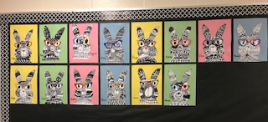
Division 9
Line Artwork

Slide 3
Division 14

Slide 4
Division 19

Slide 5
Division 17

Slide 6
Division 16

Slide 7
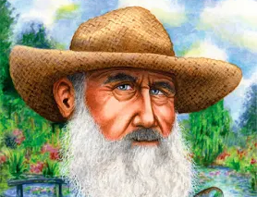
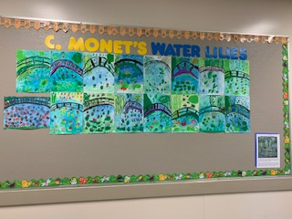
Division 12

Slide 8
Division 19

Slide 9
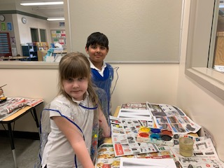
Division 17
Artists in Action

Slide 10
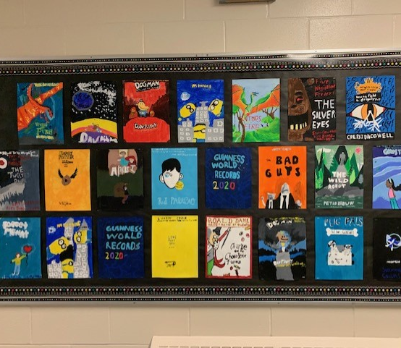
Division 4
Favourite Book Covers

Slide 11
Bike Club
Sponsored by Mr. Kerschbaum & Ms. Mitchell

Slide 12
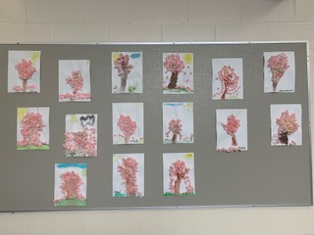
Division 15 & 16

Slide 13
Division 10

Slide 14
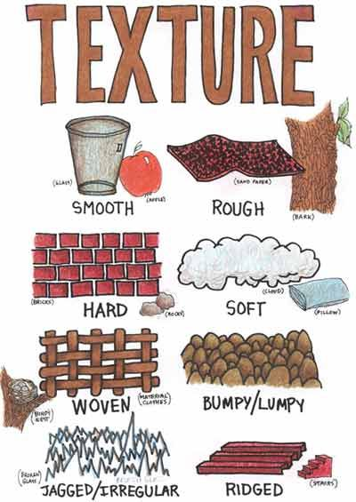
Elements of Art - Texture

Slide 15
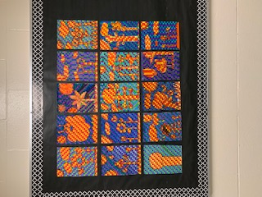
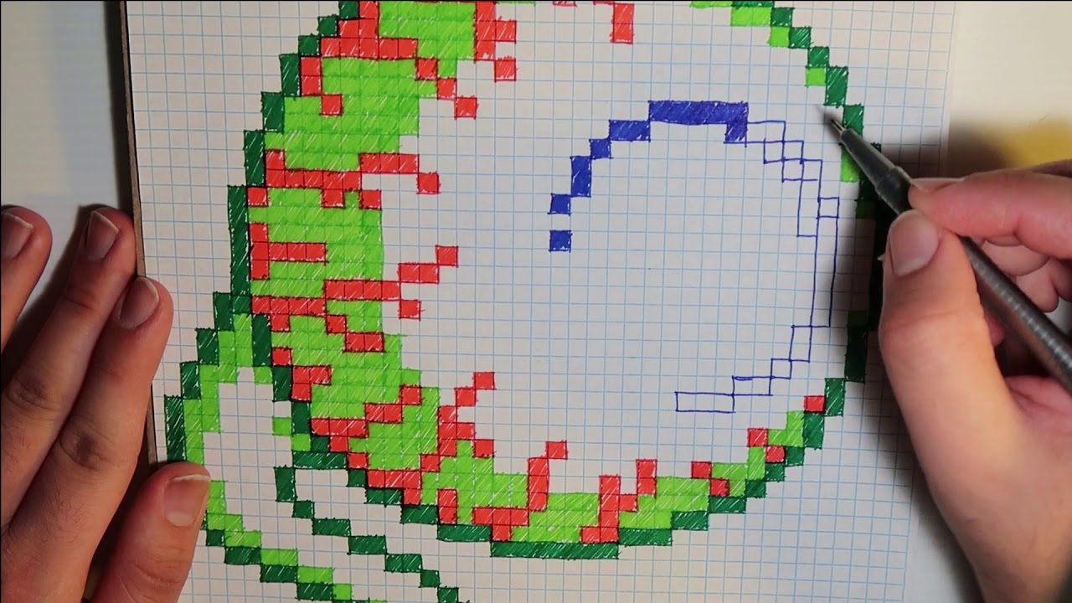
Division 9
Graph Paper Art

Slide 16
Division 4

Slide 17
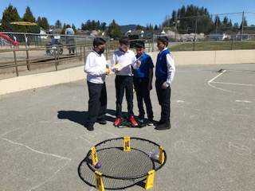
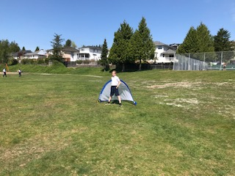
Thank You PAC
Students love the new equipment!

Slide 18
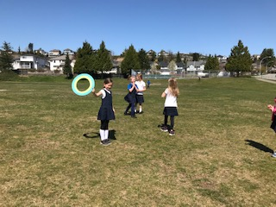
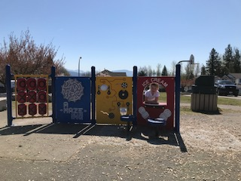
Fun in the Sun

Slide 19
Slam Ball

Slide 20
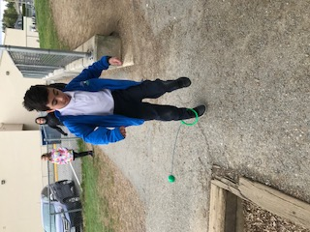
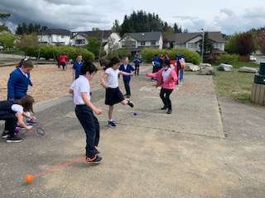
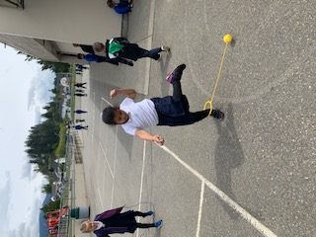
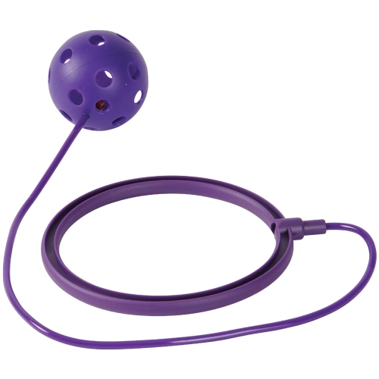
Skip It

Slide 21
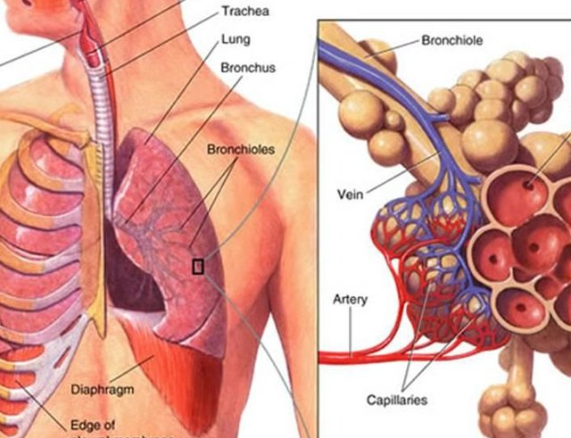
Division 4

Slide 22
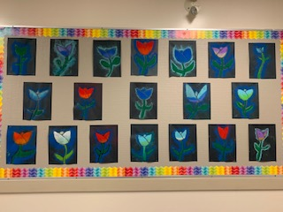
Division 13

Slide 23
Division 6

Slide 24
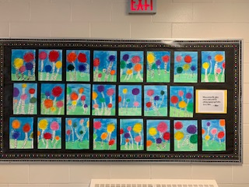
Division 6

Slide 25
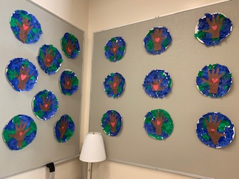
Division 14

Slide 26
Hip Hop

Slide 27
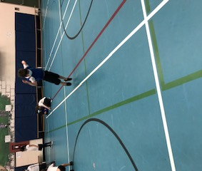
Hip Hop
Hop Like a Frog

Slide 28
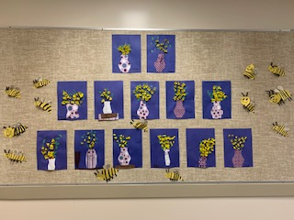
Division 11

Slide 29
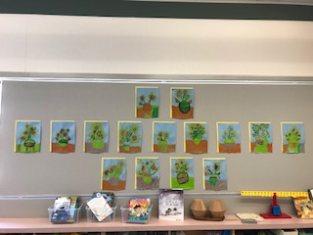
Division 14

Slide 30
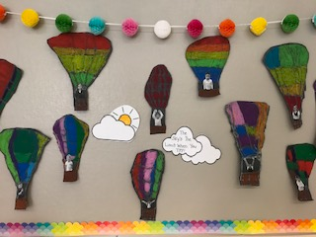
Division 15

Slide 31
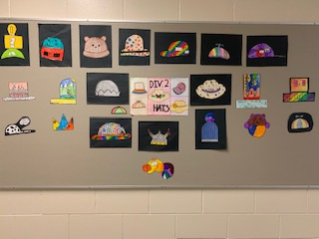
Division 2

Slide 32
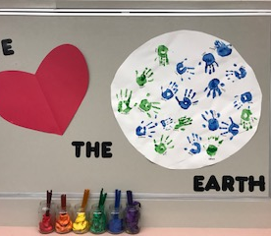
Division 19

Slide 33
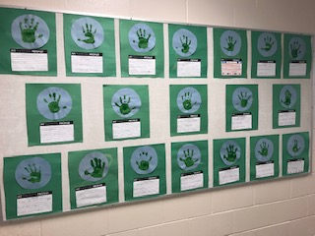
Division 17

Slide 34
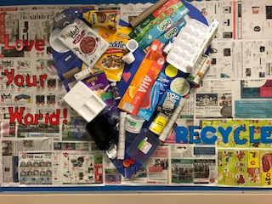
Division 13

Slide 35
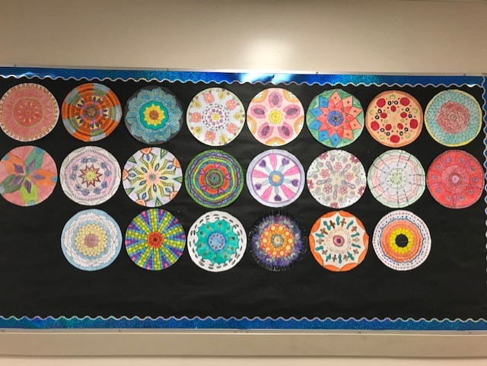
Division 3

